Slide 1

Muddiest Point Presentation 1: JOINS
Team 4 - Jason Bae, Christian Cruz, Jim Chen, Jonathan Salaver, Rounak Das
Section 0203
Due 2/28/2021

Slide 2
What is JOINS?
Used to combine columns from two or more tables into a single result set

Slide 3
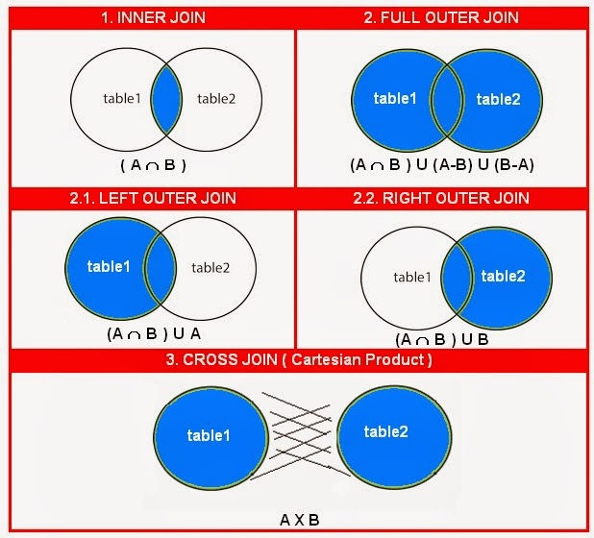
Types of JOINS
INNER JOINS
Matching Data in BOTH Left Table & Right Table
OUTER JOINS
Match in Left Table or Right Table
LEFT JOINS
Data ONLY in Left Table and matching values
RIGHT JOINS
Data ONLY in Right Table and matching values
CROSS JOINS
Each Row in Left Table joins every Row in Right Table

Slide 4
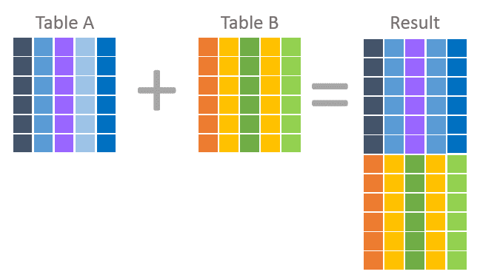
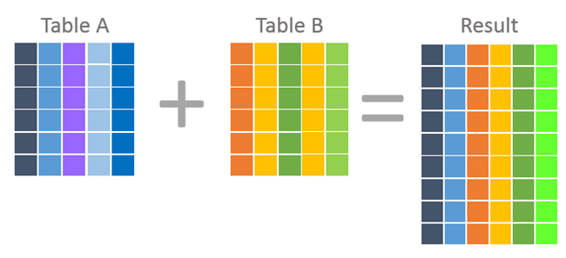
Challenging Concept
Using correct JOINS type
Using JOINS for multiple tables
JOINS vs. UNION
JOINS
UNION

